Slide 1
DISTRIBUTED SYSTEM
Remote shell using
Raw socket

Slide 2
GROUP MEMBERS
1
2
3
4
Dao Hai Long
BA9-041
Nguyen Minh Hieu
BA9-020
Dang Thai Son
BA9-053
Do Cong Hoa
BA9-022
Doan Van Chuong
5
BA9-008

Slide 3
CONTENT
Introduction
Implementation
01
02
Brief overview of the project
How we implemented the method
Conclusion
03
Done & Not done

Slide 4
01
Introduction
Brief overview of the project

Slide 5
INTRODUCTION Remote shell
Shell
Remote Shell
RSH mechanism
UI for accessing OS services
Executing shell commands across the network
Relied on IP address & DNS for authentiction

Slide 6
INTRODUCTION Raw socket
01
02
Socket
Raw socket
An endpoint for data exchange throughout the network
Direct communication between a program and an external source

Slide 7
RAW SOCKET
Bypass the normal TCP/IP processing and deliver the package to an application.
2 types: Network socket (L3) & Data link socket (L2)

Slide 8
02
Implementation
The implementation of the method

Slide 9
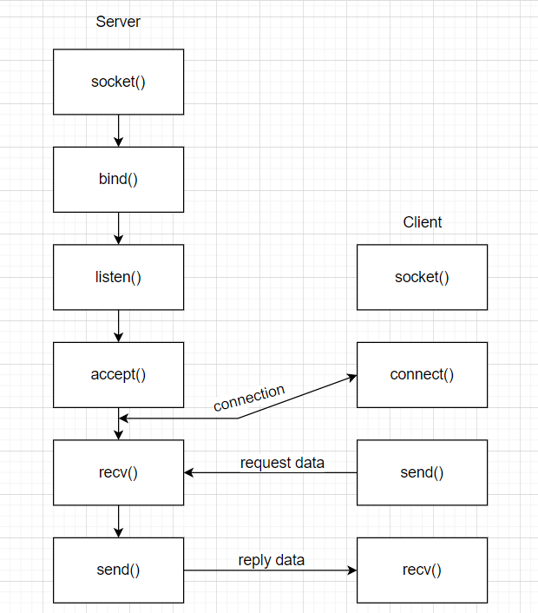

Slide 10
03
Conclusion
The implementation of the method

Slide 11
CONCLUSION
DONE
NOT DONE
Implement Data-link socket (L2)
Connection with basic command shell
Optimize the code
Try the Network socket (L3)

Slide 12
THANK YOU for your attention

